Slide 1
Land cover map
Jan 31, 2018

Slide 2
Land Cover Classification (for soy)

Slide 3
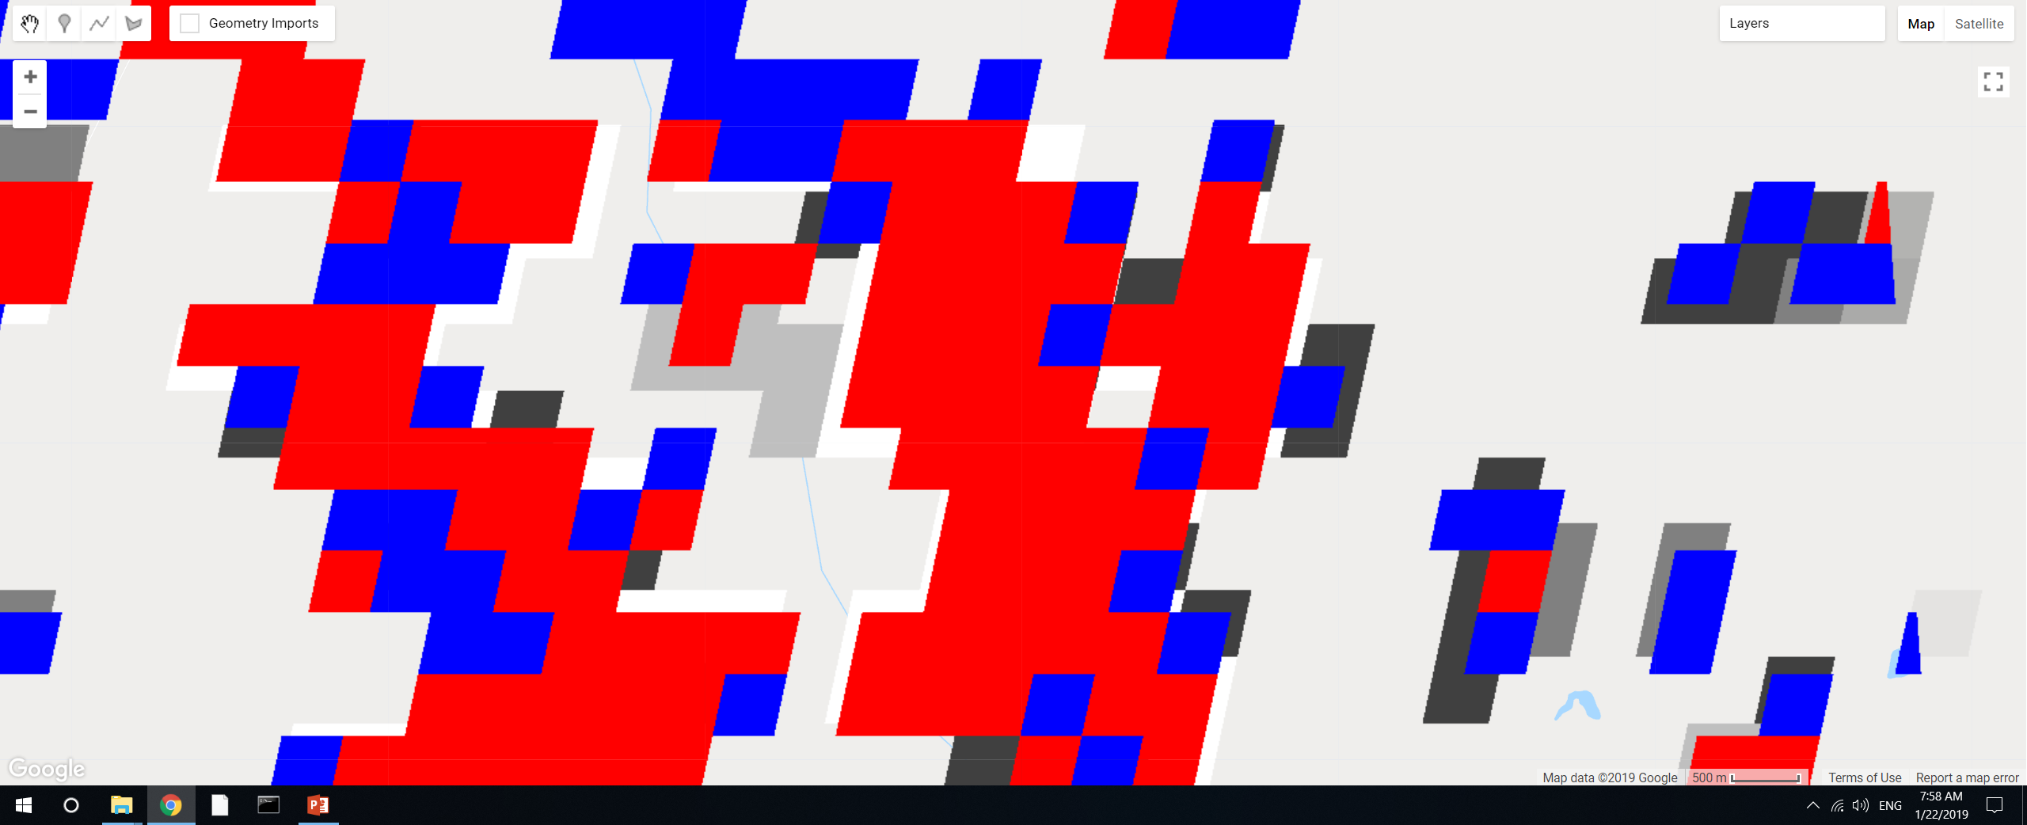
GEE file: LandCover/Soy Classification Masking
Added a small section of code to explore specifics of connectedPixelCount. Red is DC, blue is SC, underlying layer is the ‘count’ from connectedPixelCount, the areas that are not covered by red or blue are class 2 (other agri).
Use 4-connected only. The ‘connection’ is not only for adjacent pixels. So if a ‘red’ pixel is sticking out by itself but it’s connected to a large chunk of ‘red’ pixels, its connected pixels will still be high.
The values of the pixels should be integers. If they’re integers, don’t need to separately mask out DC vs SC; the connected pixels will automatically count only SC or only DC.
If pixels look like they’re only partially masked, it’s probably because they’re masked with a different map. The result of exporting an image should produce whole pixels, though the exact location of the pixels might be mismatched.

Slide 4
Validation with commercial high resolution satellite imagery
Requested quote from Satellite Imaging Corp (QuickBird) – but was directed to PlanetLabs
Images searchable on LandInfo:
GeoEye-1
WorldView-1, to -4
IKONOS
SPOT 1- 7
RapidEye
PlanetScope/Dove (Planet Labs)
QuickBird (Planet Labs)
Planet Labs satellites
PlanetScope (Planet Labs, 3m)
QuickBird (Planet Labs, 5m) – requested QuickBird quote from Satellite Imaging Corp, redirected to PlanetLabs
Prices:
SPOT 6: $2.38/km2 with a minimum order of 100km2.
RapidEye: $1.28/km2 wit minimum order of $5,000
WorldView2: $12.25/km2

Slide 5
Land Cover Classification (center pivot)

Slide 6
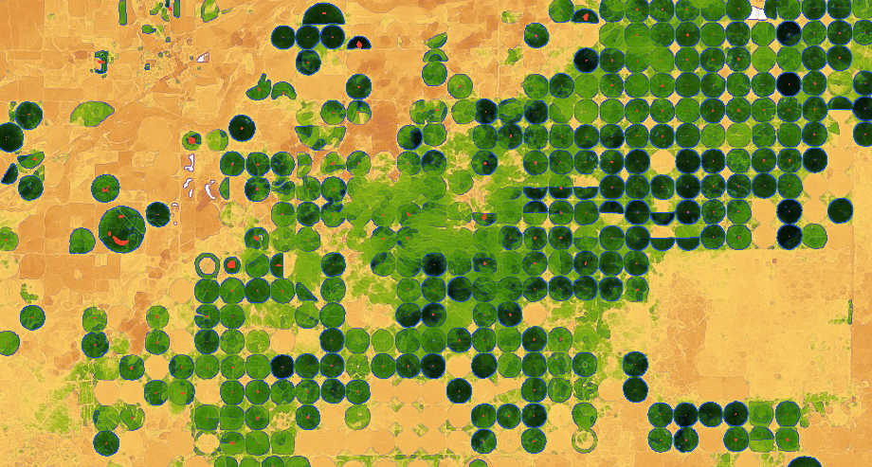
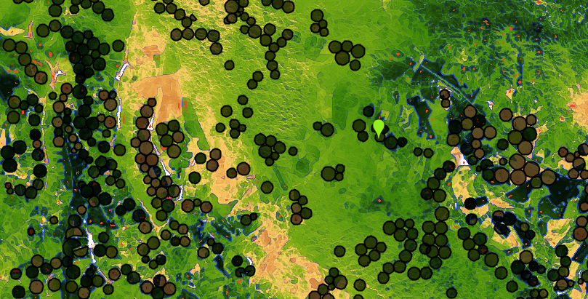
Center Pivot detection 1: Edge detection method
Challenges in applying to Brazil
Method is based on edge detection. Red = center pivot’s centroid. Black circles = 2014 center pivot data
Kansas, using Landsat 8 day EVI in April 2013
Mato Grosso, using Landsat 8 day EVI in April 2013
Observations:
Mato Grosso’s center pivot timing varies dramatically across short spans (i.e. some center pivot is yellow while others are green) – maybe need Landsat images at different times of year
Irregularly spaced center pivot and heterogeneous natural vegetation make it hard to pinpoint actual center pivot (problem for edge detection)
As-is, natural vegetation is very often misclassified as center pivot because of the edges.
Size of center pivots is very uniform in Kansas but more varied in Mato Grosso, is a problem for creating a single kernel size in edge detection
In GEE: LandCover/Center Pivot Classification

Slide 7
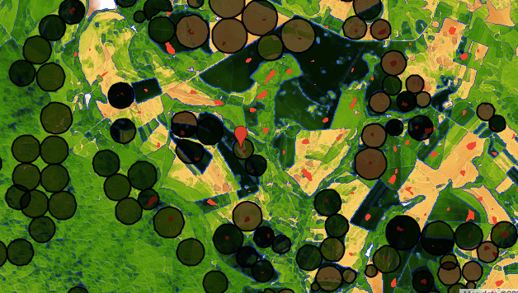
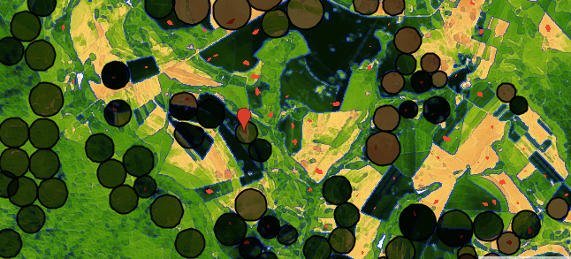
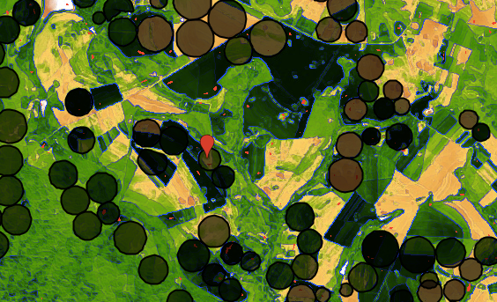
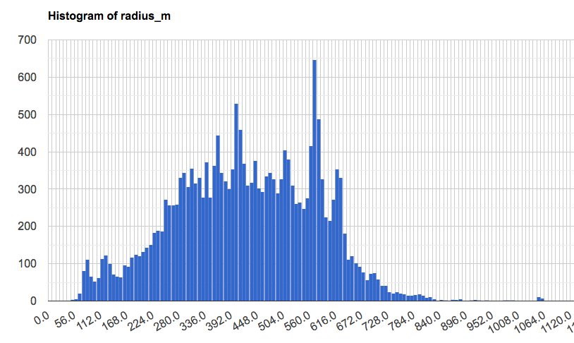
Center Pivot detection 1: Edge detection method
Sensitivity to size of kernel
Radius = 780m
Kernel size = 700m
Kernel size = 500m
Radius = 350m
Kernel size = 300m
Count
Min: 5m
Max: 1300 m
Center pivot radius [m]
In GEE: LandCover/Center Pivot Classification

Slide 8
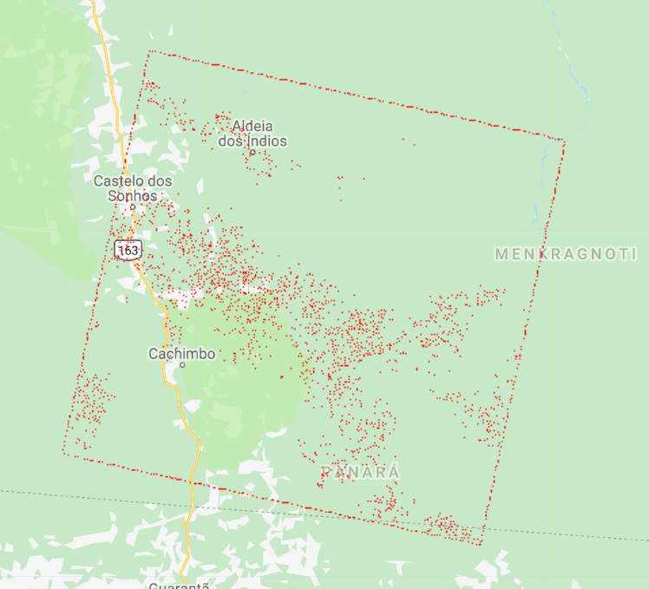
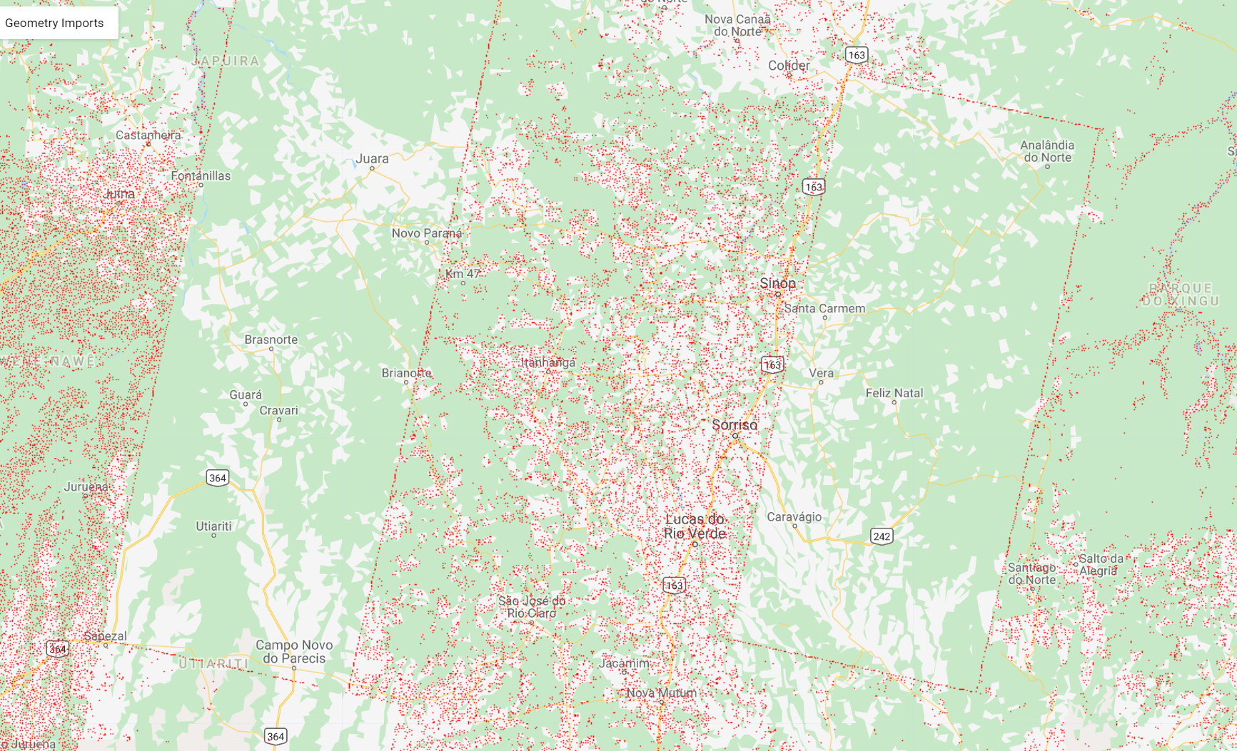
Center Pivot detection 1: Edge detection method
Edges of Landsat images are incorrectly detected as center pivot
Red = detected center of center pivot
32 day composite
8 day composite
To solve:
Turn Landsat EVI into image of 0 (for no data/water) and 10 (for EVI > 0)
Use Canny edge detection on modified Landsat EVI image
In GEE: LandCover/Center Pivot Classification

Slide 9
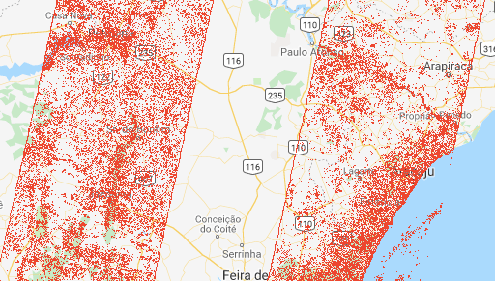
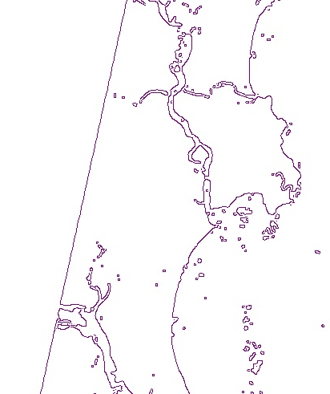
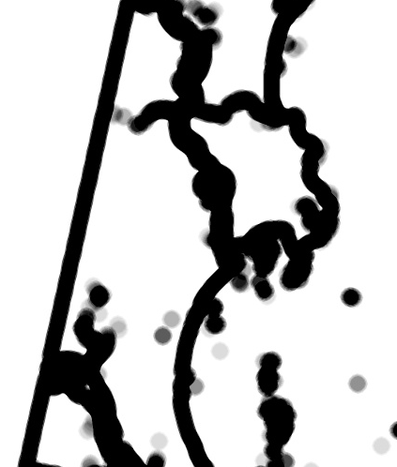
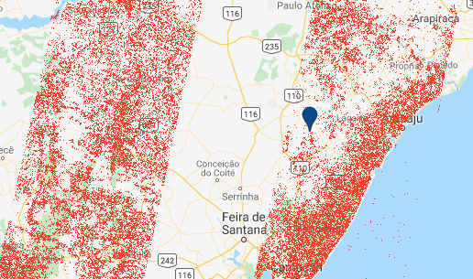
Center Pivot detection 1: Edge detection method
Edges of Landsat images are incorrectly detected as center pivot (continued)
Purple = edges detected by Canny algorithm (Landsat image edges and water body edges)
Detected center pivot before masking
Black = mask for incorrectly detected center pivot (result of a convolution with circular kernel radius = 2000m)
Detected center pivot after masking
In GEE: LandCover/Center Pivot Classification

Slide 10
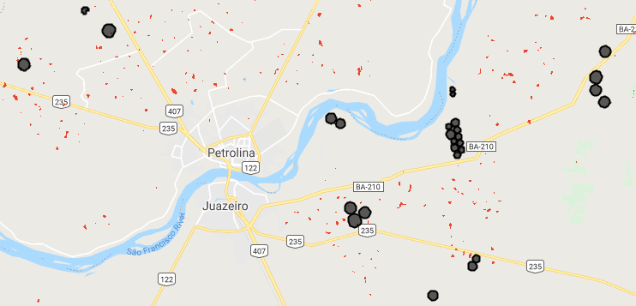
Center Pivot detection 1: Edge detection method
Turning image to features for accuracy assessment
The detected center pivot areas vary in area, need to summarize them into points and extrapolate the irrigated circle surrounding it.
reduceToVectors is not feasible at scale of Brazil
Use edge detection method to figure out radius of individual center pivots
Red = detected center pivot centroid
Circles = reported center pivot
probably a badly chosen EVI observation date
In GEE: LandCover/Center Pivot Classification

Slide 11
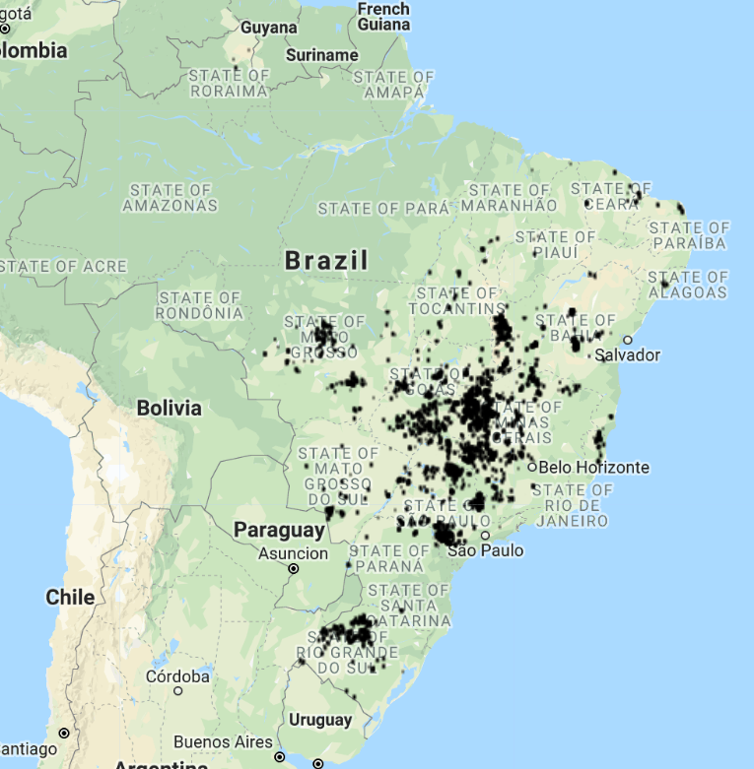
Center Pivot detection 1: Edge detection method
Set up accuracy assessment/method tuning
Randomly select 10 center pivot locations in 2014
Take 150km2 polygon around the randomly selected center pivot
Do reduceToVector, clean up neighbors within 100m (computationally intensive!)
Check overlap/nonoverlap of centroids with reported 2014 center pivot depending on:
Kernel size(s)
Landsat 8 day vs 32 day
Date of Landsat image
Landsat image edge cleaning method
Location in Brazil
2014 reported center pivot
In GEE: LandCover/Center Pivot Classification

Slide 12
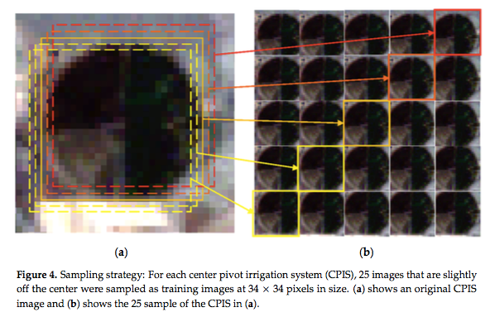
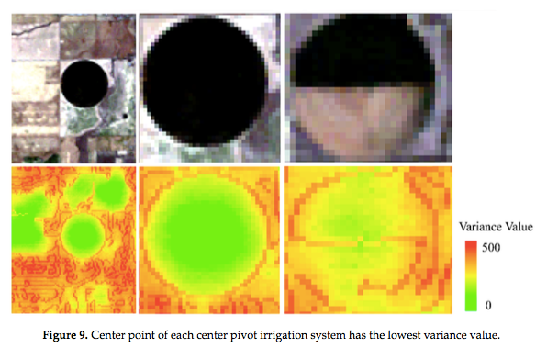
Center pivot detection 2: classifier
(Zhang et al, 2018) neural networks for detecting center pivots (in NE Colorado) – called them CPIS
Clip Landsat RGB bands on July 19, 2011 using center pivot polygons
Chose ‘representative’ CPIS with different internal shapes and colors (visually identified). All CPIS had similar sizes
Manually marked centroid of each CPIS (centroid = 0, other pixels = 0)
Trained with 300 CPIS
The inputs to classifier are images 34 x 34 pixels in size (of CPIS and non-CPIS), normalized for color
Trained on clusters of pixels
The classifier gives detected CPIS but not centroids
Variance-based approach for locating the center of CPIS – assume centroid has lowest variance

Slide 13
Center pivot detection 2: classifier
Method:
Training data: Landsat RGB or Landsat EVI over one year, clipped to the full extend of each CPIS
Train classifiers already available in GEE (not neural network)
Classify individual pixels as CPIS vs non-CPIS
Challenges:
Center pivot timing cycle varies significantly more than (Zhang et al, 2018)’s CPIS in Colorado
Depending on the field, there might be no difference between the center pivot and surrounding rainfed areas
Unsure whether GEE has ability to train on entire images (rather than band values for individual pixels)…
Advantages:
In theory, can give the actual radius of center pivot
Can simultaneously consider the whole year

Slide 14
Center pivot detection 3: classifier + edge detection combo
Since edge detection seems to overestimate the presence of CPIS, if classifier and edge detection both indicate a pixel is CPIS, then it’s CPIS
Use the results of the edge detector image (especially on multiple days) as further training data

Slide 15
Next

Slide 16
Next:
Choose center pivot detection method + produce center pivot mask
Method for taking centroid pixels and turning them into polygons of CPIS, or come up with accuracy metric that doesn’t require polygons
Plan for which images to download from Planet Labs
Temporal resolution
Location (sampled by soy area)
Cloud and view angle
QuickBird vs Planet Scope satellite
Plan for calibrating Planet Labs imagery to other satellite data

